Slide 1
Data Mining
Classification: Model Evaluation
© Tan,Steinbach, Kumar Introduction to Data Mining 4/18/2004 <number>

Slide 2
Model Evaluation
Metrics for Performance Evaluation
  How to evaluate the performance of a model?
Methods for Performance Evaluation
  How to obtain reliable estimates?
Methods for Model Comparison
  How to compare the relative performance among competing models?

Slide 3
Model Evaluation
Metrics for Performance Evaluation
  How to evaluate the performance of a model?
Methods for Performance Evaluation
  How to obtain reliable estimates?
Methods for Model Comparison
  How to compare the relative performance among competing models?

Slide 4
Metrics for Performance Evaluation
Focus on the predictive capability of a model
  Rather than how fast it takes to classify or build models, scalability, etc.
Confusion Matrix:
 | PREDICTED CLASS
ACTUAL CLASS |  | Class=Yes | Class=No
 | Class=Yes | a | b
 | Class=No | c | d
a: TP (true positive)
b: FN (false negative)
c: FP (false positive)
d: TN (true negative)

Slide 5
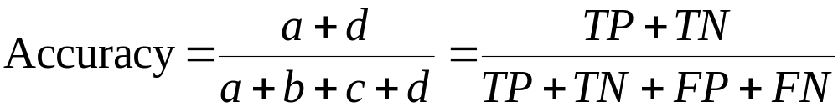
Metrics for Performance Evaluation…
Most widely-used metric:
 | PREDICTED CLASS
ACTUAL CLASS |  | Class=Yes | Class=No
 | Class=Yes | a (TP) | b (FN)
 | Class=No | c (FP) | d (TN)

Slide 6
Limitation of Accuracy
Consider a 2-class problem
  Number of Class 0 examples = 9990
  Number of Class 1 examples = 10
If model predicts everything to be class 0, accuracy is 9990/10000 = 99.9 %
  Accuracy is misleading because model does not detect any class 1 example

Slide 7
Cost Matrix
 | PREDICTED CLASS
ACTUAL CLASS | C(i|j) | Class=Yes | Class=No
 | Class=Yes | C(Yes|Yes) | C(No|Yes)
 | Class=No | C(Yes|No) | C(No|No)
C(i|j): Cost of misclassifying class j example as class i

Slide 8
Computing Cost of Classification
Cost Matrix | PREDICTED CLASS
ACTUAL CLASS | C(i|j) | + | -
 | + | -1 | 100
 | - | 1 | 0
Model M₁ | PREDICTED CLASS
ACTUAL CLASS |  | + | -
 | + | 150 | 40
 | - | 60 | 250
Model M₂ | PREDICTED CLASS
ACTUAL CLASS |  | + | -
 | + | 250 | 45
 | - | 5 | 200
Accuracy = 80%
Cost = 3910
Accuracy = 90%
Cost = 4255

Slide 9
Cost vs Accuracy
Count | PREDICTED CLASS
ACTUAL CLASS |  | Class=Yes | Class=No
 | Class=Yes | a | b
 | Class=No | c | d
Accuracy is proportional to cost if
1. C(Yes|No)=C(No|Yes) = q
2. C(Yes|Yes)=C(No|No) = p
N = a + b + c + d
Accuracy = (a + d)/N
Cost = p (a + d) + q (b + c)
= p (a + d) + q (N – a – d)
= q N – (q – p)(a + d)
= N [q – (q-p) × Accuracy]
Cost | PREDICTED CLASS
ACTUAL CLASS |  | Class=Yes | Class=No
 | Class=Yes | p | q
 | Class=No | q | p

Slide 10
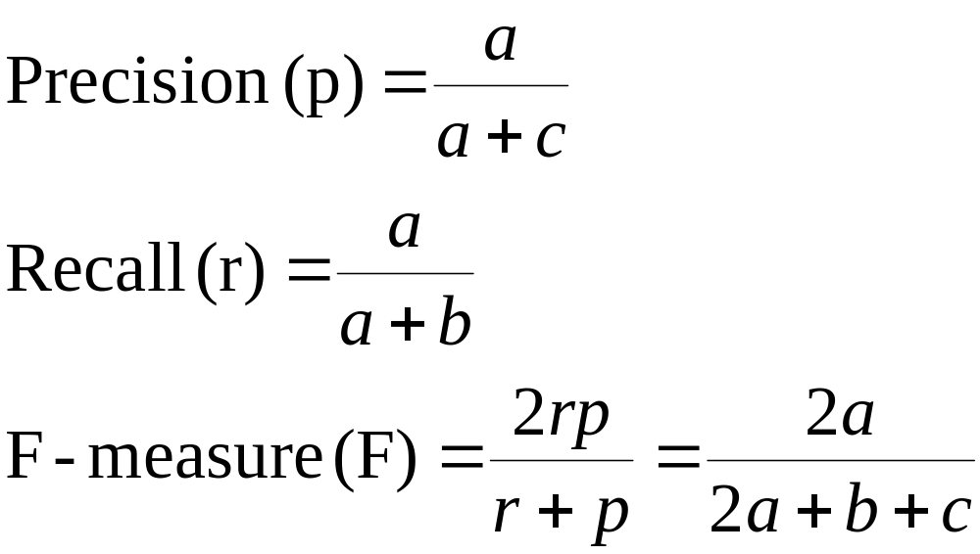
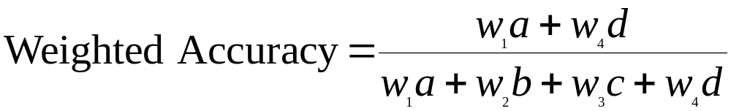
Cost-Sensitive Measures
Count | PREDICTED CLASS
ACTUAL CLASS |  | Class=Yes | Class=No
 | Class=Yes | a | b
 | Class=No | c | d
Precision is biased towards C(Yes|Yes) & C(Yes|No)
Recall is biased towards C(Yes|Yes) & C(No|Yes)
F-measure is biased towards all except C(No|No)

Slide 11
Model Evaluation
Metrics for Performance Evaluation
  How to evaluate the performance of a model?
Methods for Performance Evaluation
  How to obtain reliable estimates?
Methods for Model Comparison
  How to compare the relative performance among competing models?

Slide 12
Methods for Performance Evaluation
How to obtain a reliable estimate of performance?
Performance of a model may depend on other factors besides the learning algorithm:
  Class distribution
  Cost of misclassification
  Size of training and test sets

Slide 13
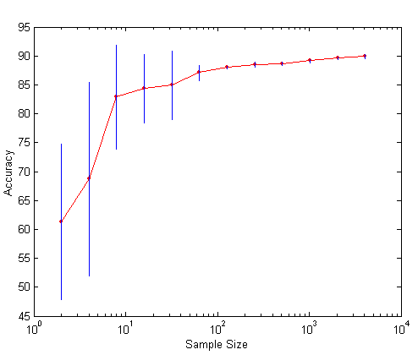
Learning Curve
Learning curve shows how accuracy changes with varying sample size
Requires a sampling schedule for creating learning curve:
  Arithmetic sampling
  (Langley, et al)
  Geometric sampling
  (Provost et al)
Effect of small sample size:
  Bias in the estimate
  Variance of estimate

Slide 14
Methods of Estimation
Holdout
  Reserve 2/3 for training and 1/3 for testing
Random subsampling
  Repeated holdout
Cross validation
  Partition data into k disjoint subsets
  k-fold: train on k-1 partitions, test on the remaining one
  Leave-one-out: k=n
Stratified sampling
  oversampling vs undersampling
Bootstrap
  Sampling with replacement

Slide 15
Model Evaluation
Metrics for Performance Evaluation
  How to evaluate the performance of a model?
Methods for Performance Evaluation
  How to obtain reliable estimates?
Methods for Model Comparison
  How to compare the relative performance among competing models?

Slide 16
ROC (Receiver Operating Characteristic)
Developed in 1950s for signal detection theory to analyze noisy signals
  Characterize the trade-off between positive hits and false alarms
ROC curve plots TP (on the y-axis) against FP (on the x-axis)
Performance of each classifier represented as a point on the ROC curve
  changing the threshold of algorithm, sample distribution or cost matrix changes the location of the point

Slide 17
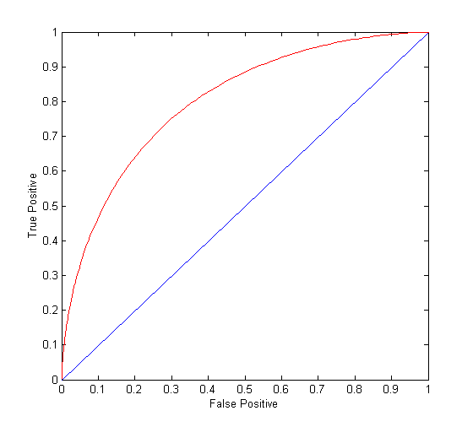
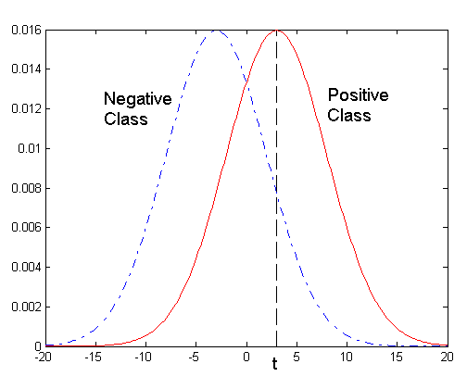
ROC Curve
- 1-dimensional data set containing 2 classes (positive and negative)
- any points located at x > t is classified as positive
At threshold t:
TP=0.5, FN=0.5, FP=0.12, FN=0.88

Slide 18
ROC Curve
(TP,FP):
(0,0): declare everything
to be negative class
(1,1): declare everything
to be positive class
(1,0): ideal
Diagonal line:
  Random guessing
  Below diagonal line:
    prediction is opposite of the true class

Slide 19
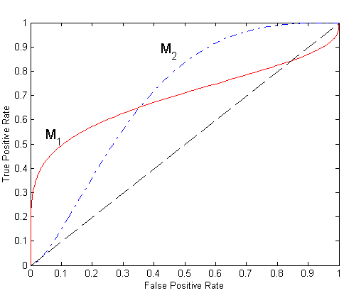
Using ROC for Model Comparison
No model consistently outperform the other
  M₁ is better for small FPR
  M₂ is better for large FPR
Area Under the ROC curve
  Ideal:
    Area = 1
  Random guess:
    Area = 0.5

Slide 20
How to Construct an ROC curve
Use classifier that produces posterior probability for each test instance P(+|A)
Sort the instances according to P(+|A) in decreasing order
Apply threshold at each unique value of P(+|A)
Count the number of TP, FP,
TN, FN at each threshold
TP rate, TPR = TP/(TP+FN)
FP rate, FPR = FP/(FP + TN)
Instance | P(+|A) | True Class
1 | 0.95 | +
2 | 0.93 | +
3 | 0.87 | -
4 | 0.85 | -
5 | 0.85 | -
6 | 0.85 | +
7 | 0.76 | -
8 | 0.53 | +
9 | 0.43 | -
10 | 0.25 | +

Slide 21
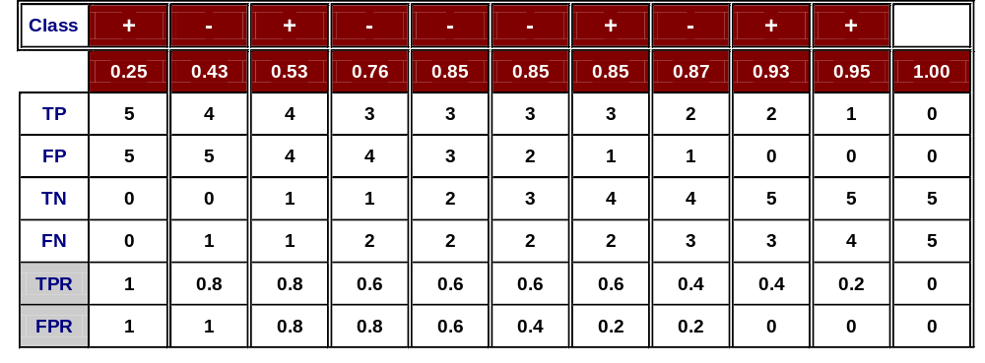
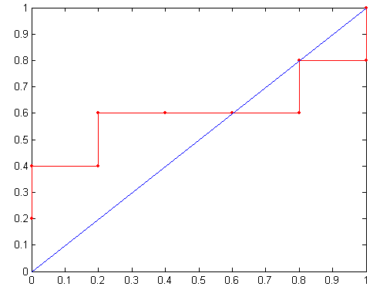
How to construct an ROC curve
Threshold >=
ROC Curve:

Slide 22
Test of Significance
Given two models:
  Model M1: accuracy = 85%, tested on 30 instances
  Model M2: accuracy = 75%, tested on 5000 instances
Can we say M1 is better than M2?
  How much confidence can we place on accuracy of M1 and M2?
  Can the difference in performance measure be explained as a result of random fluctuations in the test set?

